Slide 1
DATA NORMALIZATION
USING EXCEL POWER QUERY AND POWER PIVOT TO EXTRACT, TRANSFORM, LOAD, AND MODEL DATA

Slide 2
What is Data Normalization
Database normalization is a process used to organize a database efficiently by reducing redundancy and improving data integrity. It involves structuring a database into multiple related tables to eliminate duplication and dependency issues.
Why Normalize Data?
Reduce Redundancy – Avoid storing the same data in multiple places
Improve Data Integrity – Ensures data consistency and accuracy
Make Updates Easier – Changes, such as adding additional attributes (fields) to data, will only need to be done in one place
Enhance Query Performance – Well-structured databases perform better!

Slide 3
Relational Data Modeling - 101
Tables
Fundamental building blocks of a relational database
Each table represents an entity (Customers, Stores, Products)
Tables are composed of:
Columns: also known as fields or attributes
Rows: records of data
An Excel worksheet can be looked at as a simple table
Columns (A,B,C,D) can be named with attributes (FirstName, LastName, Age, Grade)
Rows (1,2,3,4) contain a record for each students.

Slide 4
Relational Data Modeling - 101
Primary Keys (PK)
A unique identifier for each row in a table
When you designate a field as a PK the database will impose a data constraint that enforces that the PK data is unique and will not allow duplicates.
Most database developers will create a sequence (a range of integers from which the PK is created when a new record is created.)
Example: Primary Key (PK): UserID = 1 Attributes: FirstName = “Michael” LastName = “Sauer
MySQL has AUTO_INCREMENT for primary keys

Slide 5
Relational Data Modeling - 101
Foreign Keys (FK)
A column that establishes a relationship between two tables
Always refers to the Primary Key (PK) of another table
Example:
UserID (FK) in a Playlist table links to the UserID (PK) in the Users table

Slide 6
Relational Data Modeling - 101
Relationships: define how tables are connected between PK/FK links.
One-to-one (1:1) – Each record in TableA corresponds to one record in TableB
One-to-many (1:M) - One record in TableA can have multiple records in TableB.
For example, in the Users table there is only one `UserID` (PK) representing a user because it is a primary key and has a data constraint for uniqueness. However, in the Playlist table a `UserID`(FK) can have multiple records because a user can have multiple playlists.

Slide 7
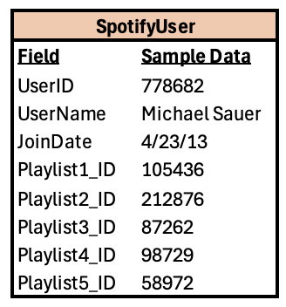
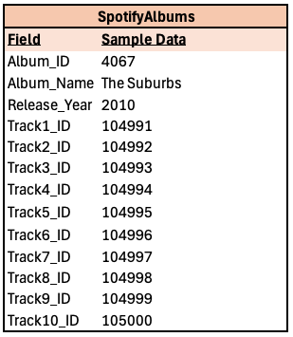

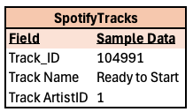
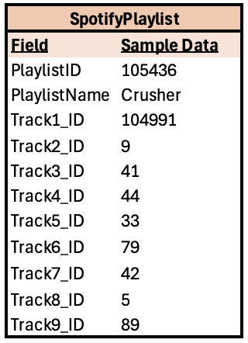
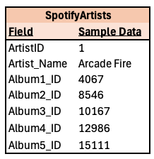
Mock Spotify Entity Relationship Diagram
Notes:
CALL OUT THE MANY TO MANY JOIN – WHAT ABOUT ALBMUS, WHERE SEVERAL ARTISTS COLLABORATED?

Slide 8
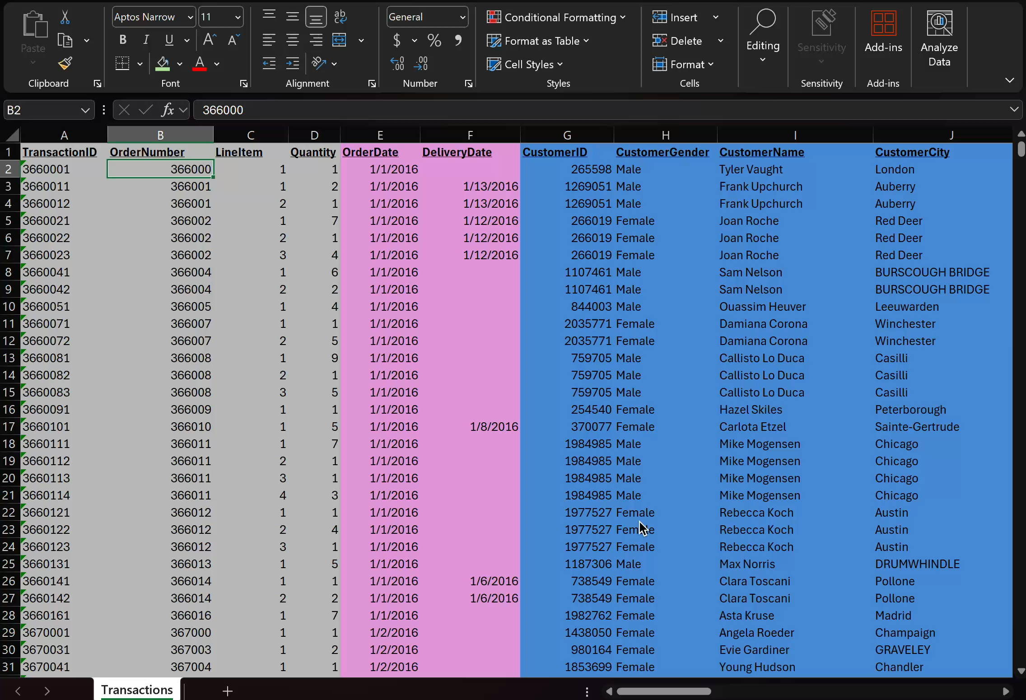
The Dataset we will be using: Transactions.xlsx
Highlighted Colors besides gray indicate dimension data we will load into a relational model.
After the sort is performed on CustomerName notice how much duplicate data is in this table!
This is a waste of memory and storage resources and can lead to data integrity issues.
The file size of the Transactions.xlsx is:
10.7 MB
11,313,152 bytes
After we normalize the data and create relationships, we will decrease the file size.

Slide 9
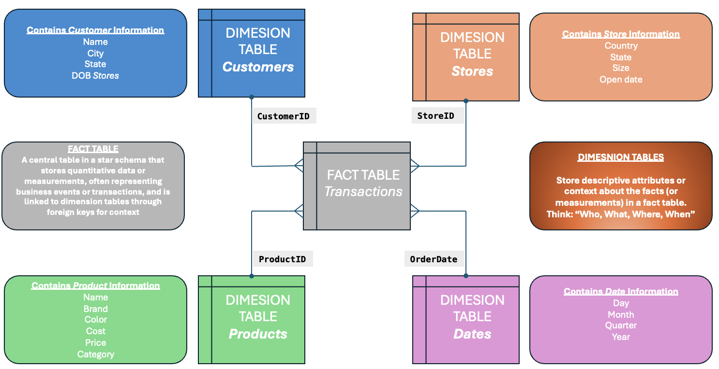
The Star Schema

Slide 10
Tools we will be using
Git and GitHub
Excel
In versions 2016 and above, Microsoft introduced Power Query to help users connect, Extract, Transform, Load, and model data directly in Excel.
Features
Data Connectivity – Connect to various data sources: Databases, cloud services, and local files like Excel and CSV
Data Transformation – Clean, filter, merge, and shape data
Automation and Refresh - Automate repetitive data transformation tasks and schedule refreshes
Integration with PowerPivot - for data modeling and creating relationships
This common practice is known as ETL

Slide 11

Getting Started
If you have Git installed on your laptop you can clone the NMU Cyber dataNormLab repository by going to your home directory and typing: git clone https://github.com/nmucyber/dataNormLab.git
This will create a dataNormLab folder in your home directory
If not, go to: https://github.com/nmucyber/dataNormLab
Click on the button, and choose “Download Zip”
This will download .zip to your Downloads directory. When you extract the zip, it will create a dataNormLab folder in your downloads directory
Open Excel and choose “blank workbook”

Slide 12
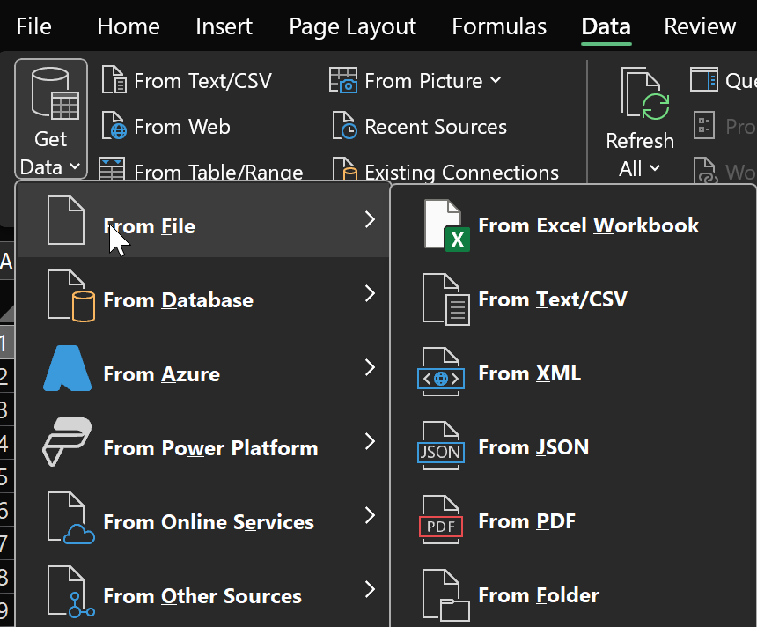
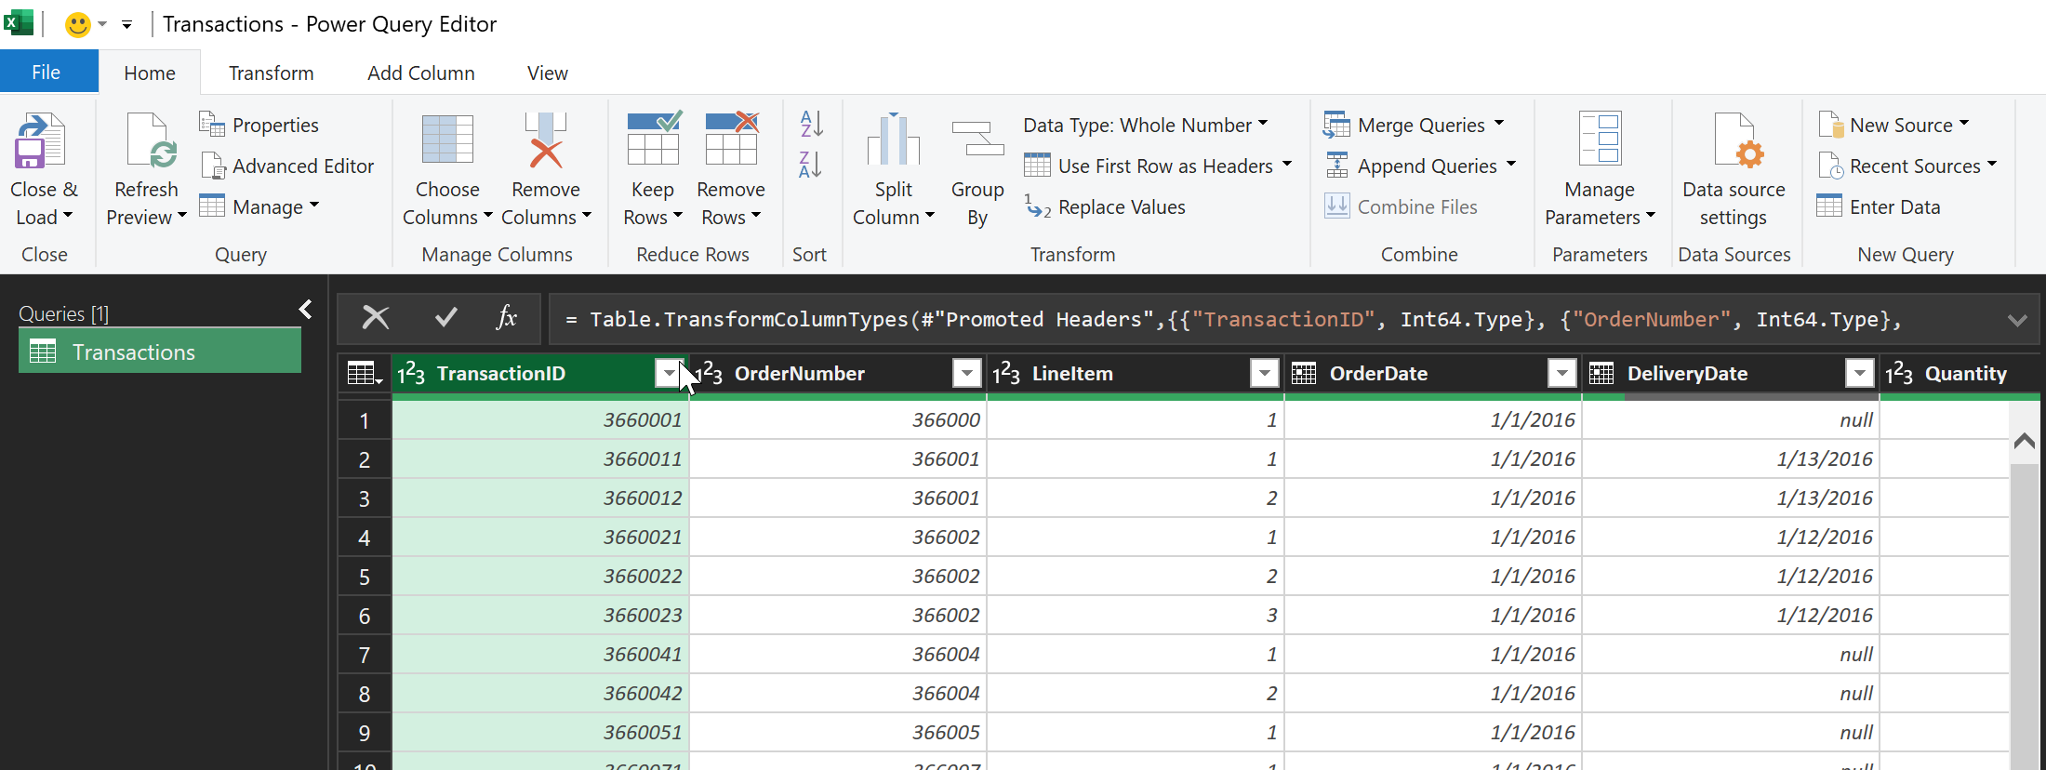
Opening Excel Power Query
Data→ Get Data →From File → From Excel Workbook. Choose Transactions.xlsx in your dataNormLab directory and click Import. This will open the preview pane. In the left pane, click on Transactions and then click on the Transform Data button, and this will open the query editor

Slide 13
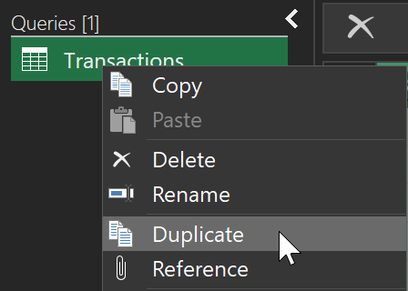
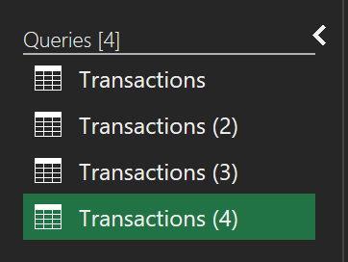
Duplicating the Query to Create Dimension Tables
In the left pane, click on the Transactions query and click duplicate. Do this (4) times.
It should now look like this.

Slide 14
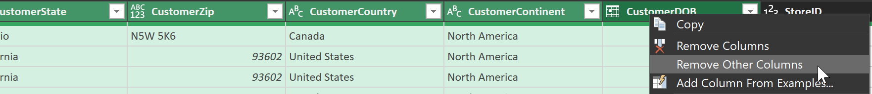
Creating the Customers Dimension
In the left pane, click on the Transactions (2) query
Shit and click on the following column headers to select them
CustomerID, CustomerGender, CustomerName, CustomerCity, CustomerStateCode, CustomerState, CustomerZip, CustomerCountry, CustomerContinent, CustomerDOB
On the highlighted columns, right-click and select “Remove Other Columns”
We now only have customer-related data remaining
Click on the drop-down arrow in the CustomerID column and choose “Sort Ascending.” You will see we have several duplicate CustomerIDs.
Remember CustomerID will be our primary key (PK) , and we must remove duplicates from the dimension table. Right-click on the CustomerID column and choose “Remove Duplicates”

Slide 15
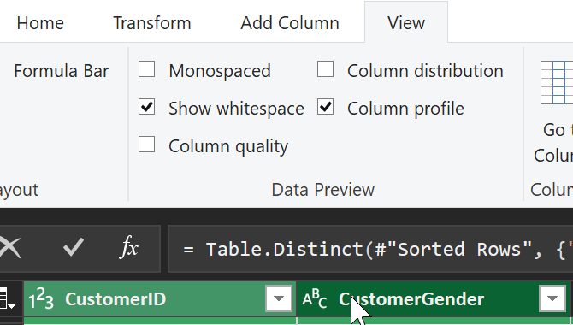
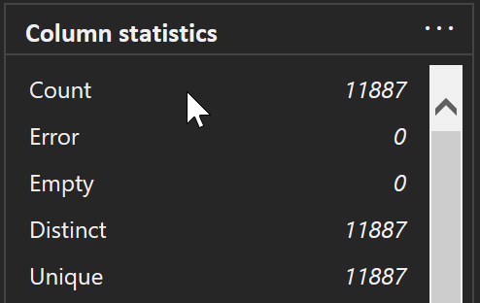
Verifying the Customers Dimension
Let’s make sure we do not have any duplicate values in CustomerID
With the CustomerID column selected, go to the view menu and click the “Column profile” checkbox. A pane at the bottom shows the record count and how many unique values exist. Below the pane, you will see the column profile is only reporting data from the first 1000 rows. Click on this and choose ”Entire Dataset”. You should see a record count of 11887 with 11887 unique values
We are done with the Customer Dimension table.
In the ”Query Settings” pane on the right side, click in the Name field and type Customers

Slide 16
Wash, Rinse, and Repeat
Follow along as I perform the same actions on creating the dimension tables for:
Stores
Products
Removing Attribute Data from the Transaction Table
Remove all columns from Transactions except:
TransactionID
OrderNumber
LineItem
OrderDate
DeliveryDate
Quantity
CustomerID
StoreID
ProductID

Slide 17
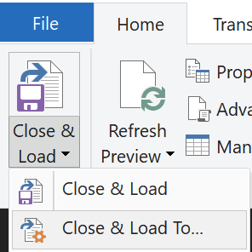
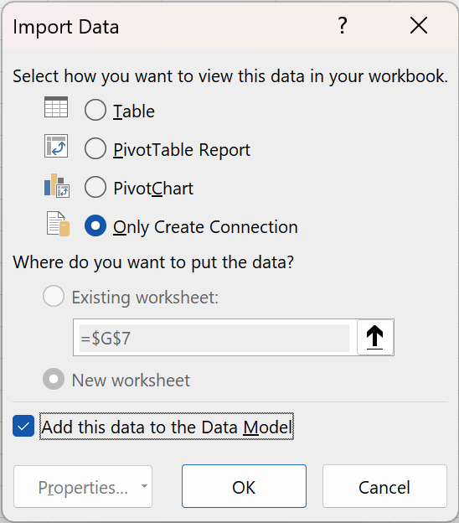
Creating the Data Model
Click: Home → Close and Load → Close and Load To
The Import Data box will pop up, choose:
Only Create Connection
Make sure the “Add this data to the Data Model” has a checkbox
Click “OK”
The Queries and Connections Pane will open and load the data into our model

Slide 18
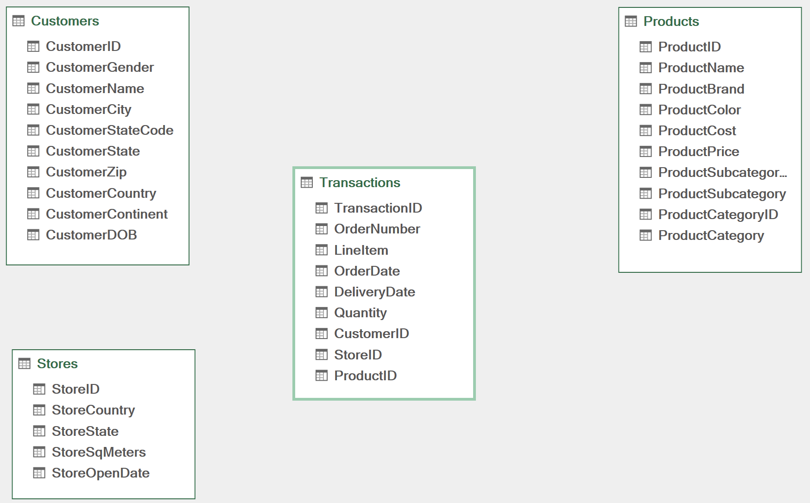
Power Pivot – Star Schema
Drag and Drop the Transactions (FACT) table to the center of the diagram
Drag and Drop the: Customers, Stores, and Products (DIMENSION) tables so they surround the fact table
It should look something like this:

Slide 19
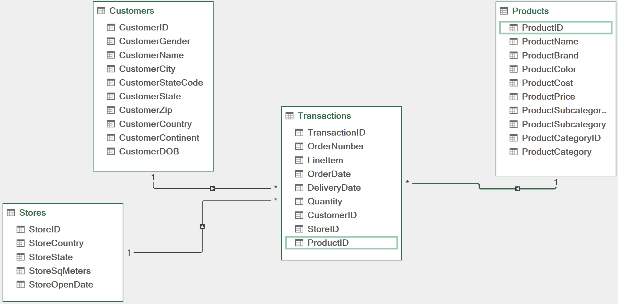
Power Pivot – Establishing Relationships
On the Customers table, click on CustomerID and drag to CustomerID in the Transactions table
On the Stores table, click on StoreID and drag to StoreID in the Transactions table
On the Products Table, click on ProductID and drag to ProductID in the Transactions table
It should look like this:

Slide 20
Normalization Benefits
By splitting Customer, Store, and Products into Dimension tables, we:
Removed over 1 million redundant data points
Reduced the Excel file size by over 70%
Significantly reduced chances of data integrity issues
Adding additional attributes to Dimensions becomes easier. For instance, if we wanted to add CustPhoneNumber, we are only updating and inserting on one table.
The data is now in a format where it can be easily uploaded to a Relational Database Management System (RDMB) like MySQL
Notes:
WHAT DID WE JUST DO?
By splitting Customer, Store and Product attributes into their own Dimension tables we:
Removed over 1 million redundant data points
Reduced our Excel file size by over 70%
Significantly reduced chances of data integrity issues
If we decided to add more attributes Customers, Store, or Products it will be much easier
The data is now in a format where it can be easily uploaded to a Relational Database Management System (RDMS) like MySQL

Slide 21
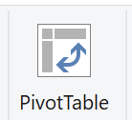
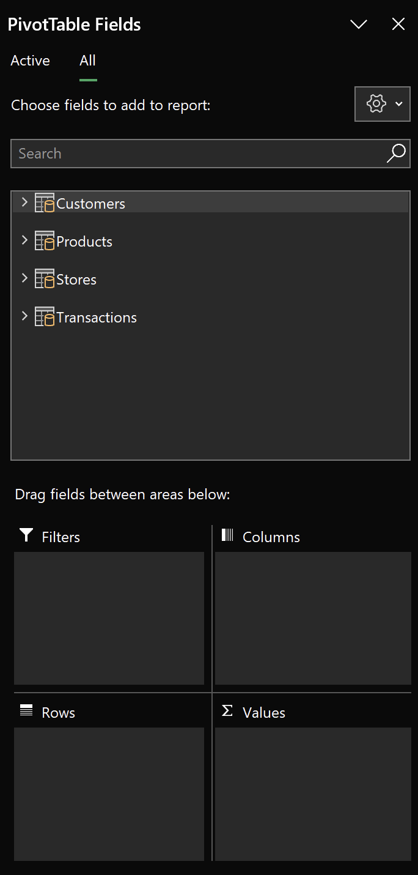
Exploring the Data
Click on the PivotTable Icon
Select Existing Worksheet and select cell A1. Those familiar with Pivot Tables will notice that the field selector looks different and displays our data model.
Expand Transactions and drag Quantity to the Values box.
Expand Products and drag ProductCategory to Rows.
You can now see that the data is being aggregated by ProductCategory!
Notes:
SHOW SORTING BY QUANTITY
SHOW COLUM ADDITION
ADD A SLICER on CUSTOMERCOUNTRY
ADD PRODUCTS AS A SUB ROW

Slide 22
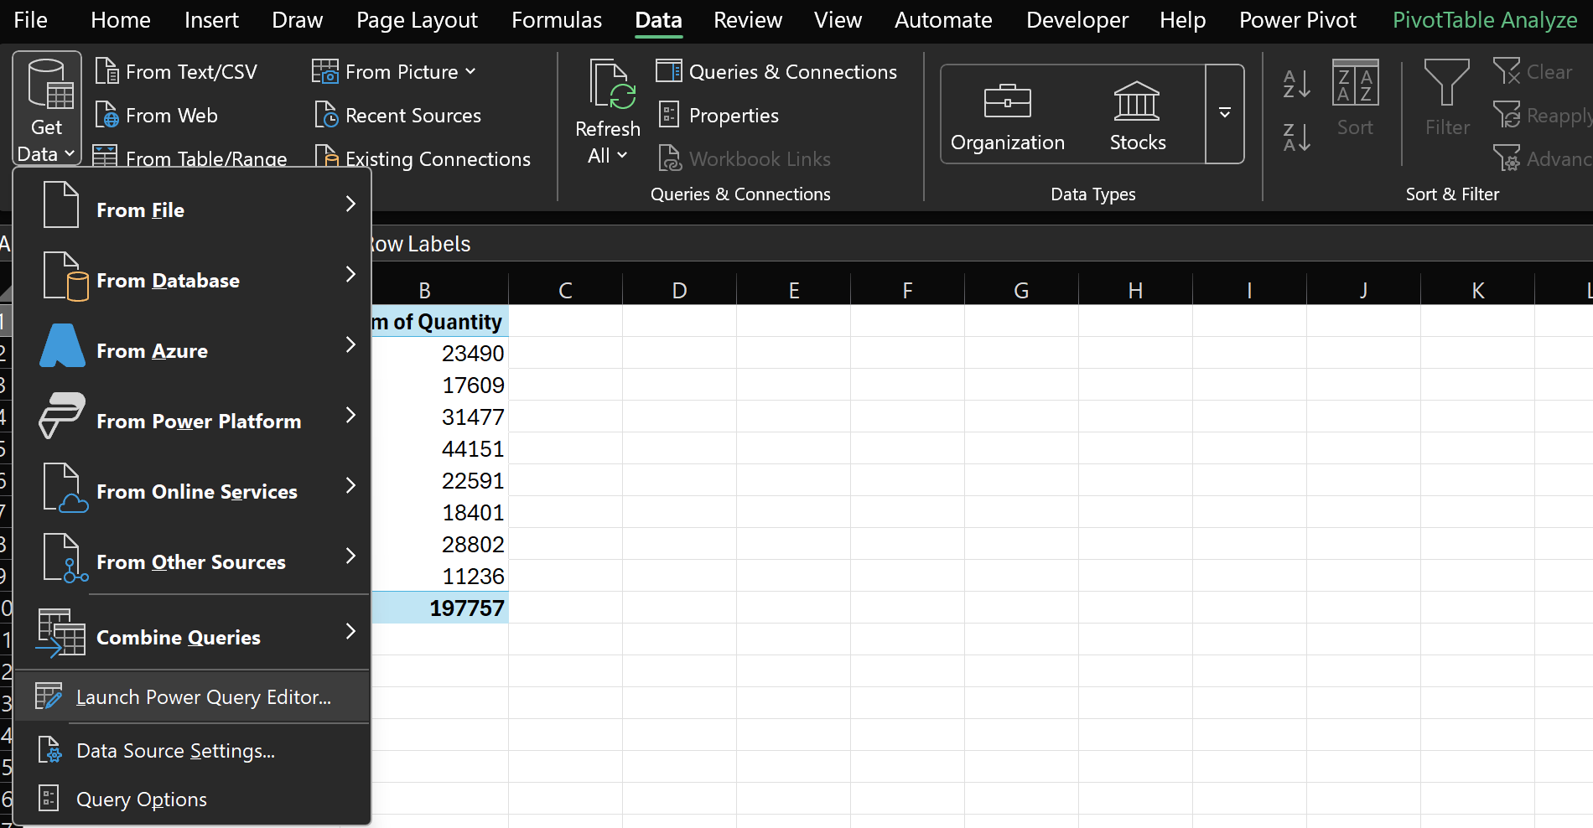
Our Boss is Happy but wants to see data by: Year, Quarter, and Month… Yikes!
Don’t worry; this is a perfect example of why we set up the data in a relational model!
Click on Data → Get Data → Launch Power Query Editor

Slide 23
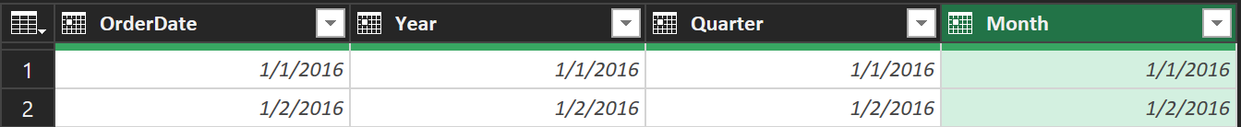
Adding a Date Dimension to the Model
Right-click on Transactions and select Duplicate
Double-click on Transactions(2) and name it Dates
Right-click on the OrderDate column header and select “Remove Other Columns”
Now, only the OrderDate will remain. Right-click on the column header and select “Remove Duplicates”
Right-click on the OrderDate column header and select “Duplicate Column.” do this (3) times. You will now have (4) columns
On each copied column, right-click and select “Rename”
Rename the copied columns: Year, Quarter, Month

Slide 24
Transforming the Date Dimension Fields
Right-click on the Year column header and select “Transform” and then select “Year”
Right-click on the Quarter column header and select “Transform” and then select “Quarter”
Right-click on the Month column header and select “Transform” and then select “Month” and then “Name of Month”
Power Query will use the Date data type to transform the date into the desired date measures.
Select Close and Load → Close and Load To → Only Create Connection, and make sure “Add this data to the Data Model” is checked. Click OK.
Now , we must go back to PowerPivot and add a relationship from the Dates table to the Transactions Table. From Dates, drag OrderDate to the OrderDate field in transactions

Slide 25
THANKS!
Due to time constraints, we only normalized the data to Second Normal Form (2NF).
Questions ???

